Slide 1
Connectionist Computing
COMP 30230/41390
Gianluca Pollastri
office: CASL, ground floor Science East.
email: gianluca.pollastri@ucd.ie
Connectionist Computing COMP 30230

Slide 2



Credits
Geoffrey Hinton, University of Toronto.
  borrowed some of his slides for “Neural Networks” and “Computation in Neural Networks” courses.
Ronan Reilly, NUI Maynooth.
  slides from his CS4018.
Paolo Frasconi, University of Florence.
  slides from tutorial on Machine Learning for structured domains.
Connectionist Computing COMP 30230

Slide 3
Lecture notes on Moodle
https://csmoodle.ucd.ie/moodle/course/view.php?id=288
Strictly confidential...
Enrolment key: 30230cc
Connectionist Computing COMP 30230

Slide 4
Books
No book covers large fractions of this course.
Parts of chapters 4, 6, (7), 13 of Tom Mitchell’s “Machine Learning”
Parts of chapter V of Mackay’s “Information Theory, Inference, and Learning Algorithms”, available online at:
http://www.inference.phy.cam.ac.uk/mackay/itprnn/book.html
Chapter 20 of Russell and Norvig’s “Artificial Intelligence: A Modern Approach”, also available at:
http://aima.cs.berkeley.edu/newchap20.pdf
More materials later..
Connectionist Computing COMP 30230

Slide 5
Marking
3 landmark papers to read, and submit a 10-line summary on Moodle about: each worth 6.67%
a small connectionist tool to build and play with: 30%
Final exam: 50%
Connectionist Computing COMP 30230

Slide 6
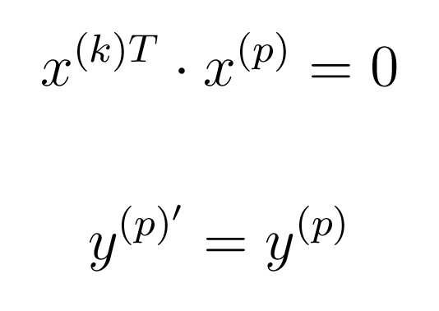
.. finally
If the input patterns are orthogonal the associator shows perfect memory:
If not orthogonal, “crosstalk”
Connectionist Computing COMP 30230

Slide 7
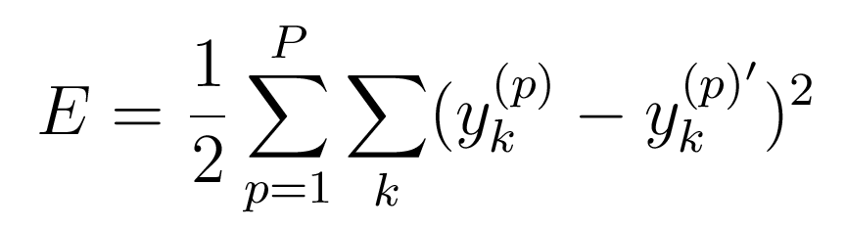
Minimise squared error
A possible error function:
Connectionist Computing COMP 30230

Slide 8
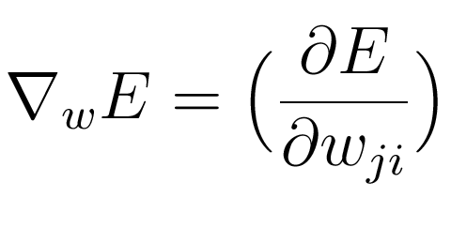
Gradient descent
We can measure the slope of the error function with respect to the parameters, and follow the direction of steepest descent:
Connectionist Computing COMP 30230

Slide 9
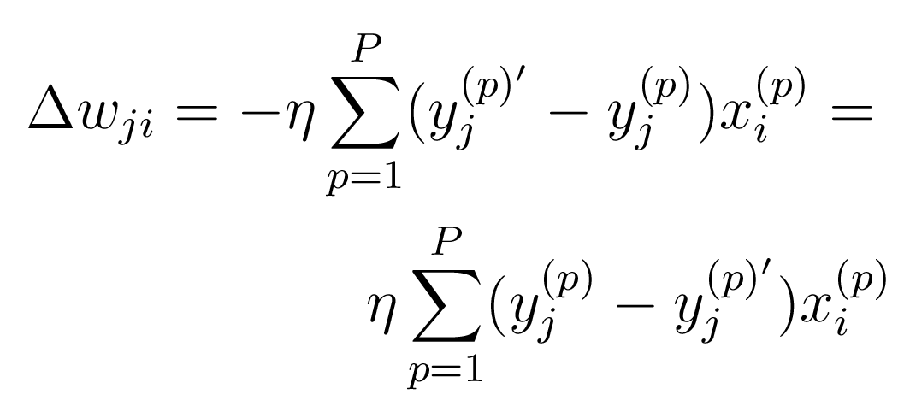
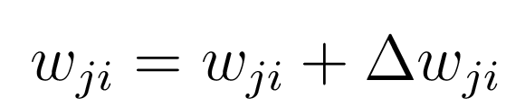
Fairly similar to Hebb’s law
Iterate until satisfied:
Connectionist Computing COMP 30230

Slide 10
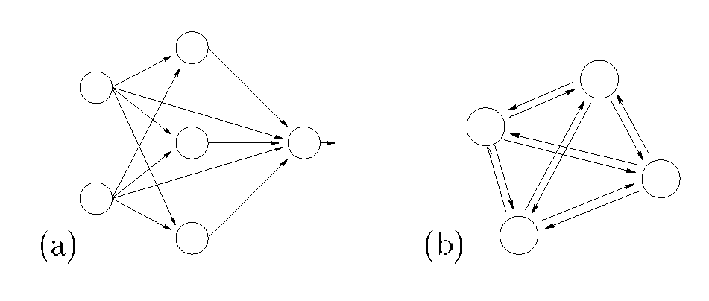
Feedforward and feedback networks
FF is a DAG (Directed Acyclic Graph). Perceptrons, Associators are FF networks.
FB has loops (i.e., not Acyclic)
Connectionist Computing COMP 30230

Slide 11
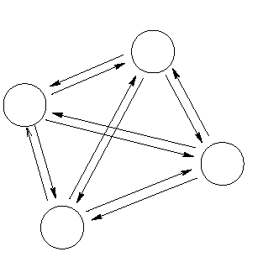
Hopfield Nets
Networks of binary threshold units.
Feedback networks: each units has connections to all other units except itself.
Connectionist Computing COMP 30230

Slide 12
Hopfield Nets
wji is the weight on the connection between neuron i and neuron j.
Connections symmetric, i.e. wji = wij
Connectionist Computing COMP 30230

Slide 13
Stable states in Hopfield nets
These networks are not FF. There is no obvious way of sorting the neurons from inputs to outputs (every neuron is input to all other neurons).
In which order do we update the values on the units?
  Synchronous update: all neurons change their state simultaneously, based on the current state of all the other neurons.
  Asynchronous update: e.g. one neuron at a time.
Is there a stable state (i.e. a state that no update would change)?
Connectionist Computing COMP 30230

Slide 14
Energy function in Hopfield nets
Given that the connections are symmetric (w_{ij} = w_{ji}), it is possible to build a global energy function. According to it each configuration (set of neuron states) of the network can be scored.
It is possible to look for configurations of (possibly locally) minimal energy. In fact the whole space of weights is divided into basins of attraction, each one containing a minimum of the energy.
Connectionist Computing COMP 30230

Slide 15
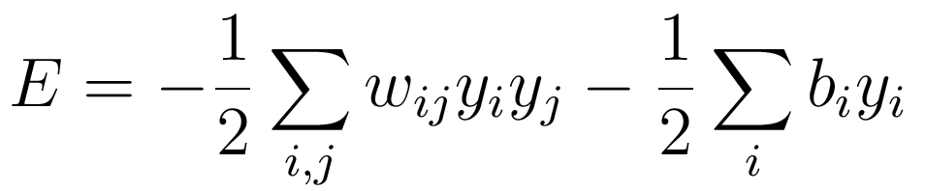
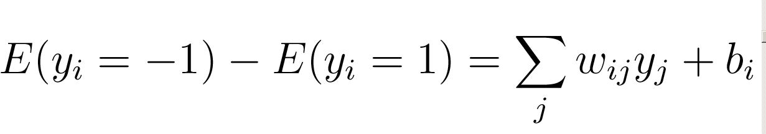
The energy function
The global energy is the sum of many contributions. Each contribution depends on one connection weight and the binary states of two neurons:
The simple energy function makes it easy to compute how the state of one neuron affects the global energy (it is the activation of neuron!):
Connectionist Computing COMP 30230

Slide 16
Settling into an energy minimum
Pick the units one at a time (asynchronous update) and flip their states if it reduces the global energy.
If units make simultaneous decisions the energy could go up.
-4
3 2 3 3
-1 -1
-100
0
0
+5
+5
Connectionist Computing COMP 30230

Slide 17
Hopfield network for storing memories
Memories could be energy minima of a neural net.
The binary threshold decision rule can then be used to clean up incomplete or corrupted memories.
  This gives a content-addressable memory in which an item can be accessed by just knowing part of its content
  Is it robust against damage?
Connectionist Computing COMP 30230

Slide 18
Example
Training set
The corrupted pattern for "3" is input and the network cycles through a series of updates, eventually restoring it.
Connectionist Computing COMP 30230

Slide 19
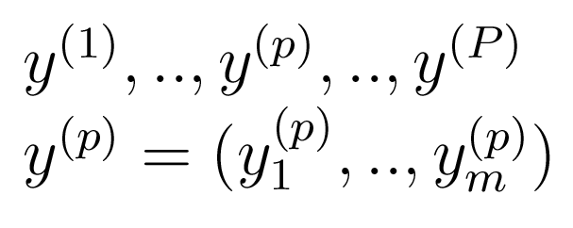
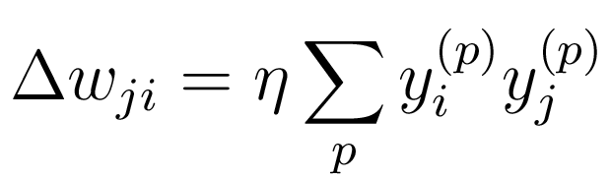
Storing memories (learning)
If we want to store a set of memories:
if the states are –1 and +1 then we can use the update rule:
Connectionist Computing COMP 30230

Slide 20
Example
Two patterns:
y⁽¹⁾=(1 –1 1) and y⁽²⁾= (-1 1 –1)
Say we want η=1/neurons=1/3
What is W?
Connectionist Computing COMP 30230

Slide 21
Example
0 –2/3 2/3
-2/3 0 –2/3
2/3 –2/3 0
?
Connectionist Computing COMP 30230

Slide 22
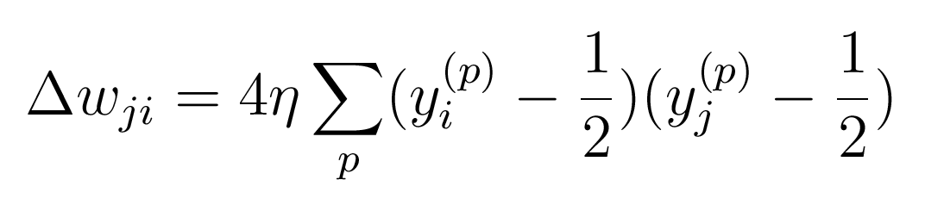
Storing memories (learning)
If neuron states are 0 and 1 the rule becomes slighty more complicated:
Connectionist Computing COMP 30230

Slide 23
Hopfield nets with sigmoid neurons
Perfectly legitimate to use Hopfield nets with sigmoid neurons instead of binary-threshold- ones.
The learning rule remains the same.
Connectionist Computing COMP 30230

Slide 24
Learning problems
Each time we memorise a configuration, we hope to create a new energy minimum.
But what if two nearby minima merge to create a minimum at an intermediate location (spurious minima)?
How many minima can we store in a network before they start interfering with each other?
Can other minima coexist with the learned ones?
Connectionist Computing COMP 30230

Slide 25
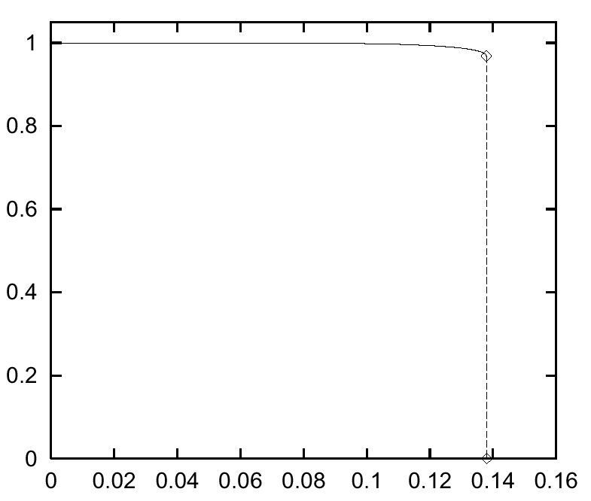
Critical state
There is a critical state around P/N=0.14, where P=memories and N=number of neurons. Above it the probability of failure increases drastically.
Connectionist Computing COMP 30230

Slide 26
Critical state
P/N > 0.14 : no minimum is related to the learned patterns.
0.14 > P/N > 0.05 : both learned and other minima. Other minima tend to dominate.
0.05 > P/N > 0 : both learned and other minima. Learned minima dominate (lower energy).
Connectionist Computing COMP 30230

Slide 27
An iterative storage method
Instead of trying to store vectors in one shot as Hopfield does, cycle through the training set many times and make small weight changes.
  This uses the capacity of the weights more efficiently.
  Very much like Kohonen’s extension to Linear Associators.
Connectionist Computing COMP 30230

Slide 28

Example
Say we have 4 patterns of size 4:
(1, -1, -1, -1)
(-1, 1, -1, -1)
(-1, -1, 1, -1)
(-1, -1, -1, 1)
We build the sigmoid Hopfield net based on the 4 patterns (Matlab nnet toolbox).
Incidentally, here one-shot learning would not work: try.
Connectionist Computing COMP 30230

Slide 29

Example
Let’s now start from some state Y for the neurons, and watch the network evolve.
Y=(1 0 0 0)
Steps (1 update/neuron):
1: (0.4999 -0.6620 -0.6620 -0.6620)
2: (0.5022 -0.8476 -0.8476 -0.8476)
3: (0.6351 -0.9332 -0.9332 -0.9332)
4: (0.8186 -1.0000 -1.0000 -1.0000)
5: (1 -1 -1 -1) converged to pattern 1!
Connectionist Computing COMP 30230

Slide 30

Example (2)
Different starting point:
Y=(0 0 0 0)
Steps:
1: (-0.4273 -0.4273 -0.4273 -0.4273)
2: (-0.5226 -0.5226 -0.5226 -0.5226)
3: (-0.5439 -0.5439 -0.5439 -0.5439)
4: (-0.5486 -0.5486 -0.5486 -0.5486)
..
7: (-0.55 -0.55 -0.55 -0.55) stuck in the middle!
Connectionist Computing COMP 30230

Slide 31
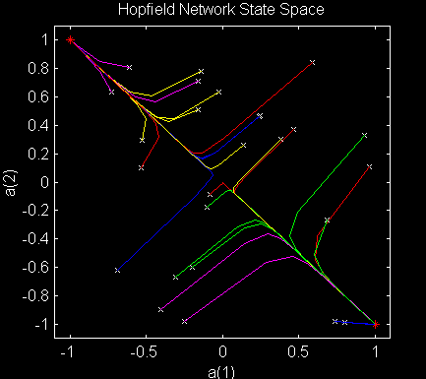
Connectionist Computing COMP 30230

Slide 32
Example (3)
Let’s now try train a Hopfield net on slightly nastier vectors (the previous ones were orthogonal):
(1.0000 -1.0000 -1.0000 0.3000)
(0.1000 1.0000 -1.0000 -0.1000)
(-1.0000 -1.0000 1.0000 -0.5000)
(-1.0000 -1.0000 -1.0000 1.0000)
Connectionist Computing COMP 30230

Slide 33
Example (3)
Let’s start from some state Y for the neurons, and watch the network evolve.
Y=(1 0 0 0)
Steps (1 update/neuron):
1: (0.9957 -0.3693 -0.3693 -0.0028)
5: (1.0000 -0.5332 -0.5332 -0.0040)
50: (1.0000 -0.5348 -0.5348 -0.0040) odd plateau
170: (1.0000 -0.5345 -0.5350 -0.0040)
5000: (1.0000 0.2032 -1.0000 1.0000) spurious min!
Connectionist Computing COMP 30230

